Slide 1
Parcel Handling
Simulation Application
GDS group 3

Slide 2
Group Members
Sebastien Lepage
Antoine Girard
Kristian Kolev
Ginika Ibeagha
Qian Li (Group Leader)

Slide 3
Assignment
To design and implement a parcel handling simulation application that resembles that used in airports
Should include components drop-off and destination gates as well as sorters, storage, parcels, conveyors
Should be a distributed system
Simulation of parcels on paths from drop-off points to specific destinations using sorters, storage etc. should be possible.
parcel dimension diversity, storage facility, belt speed etc. can be added to the simulation.

Slide 4
Assignment Process
Iterative Application Development (IAD) approach
3 IAD’s to be carried out after Project Plan and Design Document clarifying the exact technical nature of the application.
Each cycle would involve the addition of functional elements to the application
the idea would be to use 3 IAD’s to achieve our target of a fully functioned parcel handling the simulation application.

Slide 5
Iterations
Functional Test Plan – the Group and the Tutor
Period | Test Content (the group)
1st iteration | Code for basic functions, performance of basic functions like New, Save, Add component, etc
2nd iteration | Code for the algorithm for sorting parcels, how the sorters and storages work
3rd iteration | Code for the distributed system, and all the codes should function well, the overall performance of the application

Slide 6
Components
Sorter:
An object in the application that has a function of getting parcel information and guiding the parcel further to its corresponding destination gate.
Check-in gate:
An application component with the function of getting the end destination information and other needed information used in handling the parcels. Entry point for all parcels will enter in the simulation.
Destination gate (with storage):
A point of the exit of the parcels from the simulation, sorter uses the position of the destination gates to determine the direction of parcels. Each destination gate is automatically generated with a storage which is used for storing parcels for later flights. If there are more flights at that destination gate, the parcels will be put to the storage first then go to the flights.

Slide 7
Components (contd.)
Parcels:
The objects being moved from one check-in gate to one destination gate. When checked in the parcels are given random values that determine its destination gate. On their creation by the check-in desks they are assigned a destination gate, after which they are routed directly to there by the sorters.
Conveyor:
This component is available in 4 varieties - horizontal, vertical and two diagonals. It connects all other components together into a logical parcel handling simulation.

Slide 8
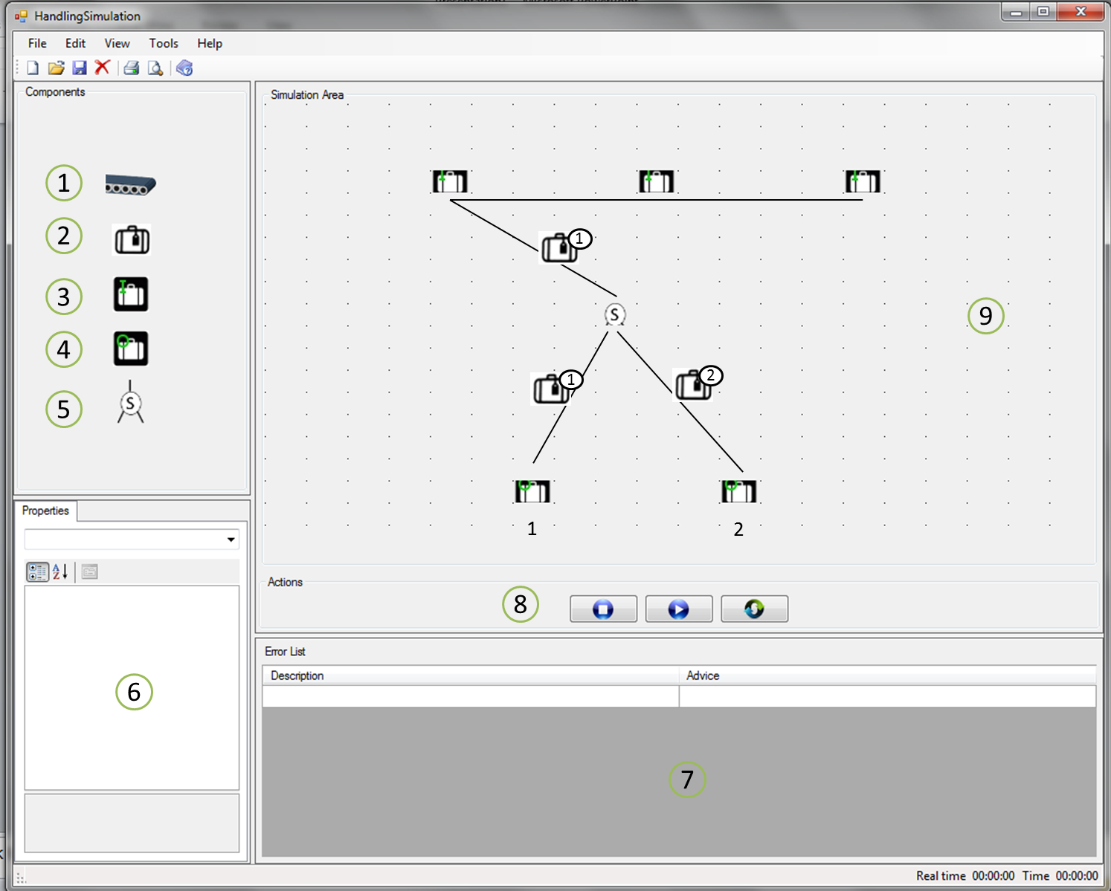
User Interface
Component Bar
Simulation Area
Property Bar
Output Control

Slide 9
MoSCoW Matrix
Functions | M | S | C | W
Distributed System Client-Server-Worker Functionality
Distributed System, Worker mesh Network
New Simulation
Open Simulation
Save
Save as
Exit
Start Simulation
Stop Simulation
Pause Simulation
Add components
Draw conveyors
Remove object
Set parcel simulation properties
Set conveyor belt speed
Set simulation speed

Slide 10
Demonstration of Final Project
New simulation
Save as
Save
Open
Exit
Start simulation
Pause simulation
Stop simulation
Add component
Draw conveyors
Remove object
Set parcel simulation properties
Set conveyor belt speed
Set simulation speed Test Scenarios

Slide 11
Thank You for your Attention
Any questions?

